Slide 1
TESE for ICSI: Influence of Motility and Vitality
BY
OGUNYEMI, Oluwatosin Emmanuel
(Btech, MSc, SCEmb)
Clinal Embryologist of Nigeria’s Ambassador
23rd September2021

Slide 2
INTRODUCTION
The incidence of azoospermia is estimated to be 1.9% ¹in the general population and 15% of infertile men². Azoospermia can be Obstructive (OA) or Non-Obstructive (NOA).
ART treatments can be focused on obtaining adequate sperm samples for ICSI these sperm cells can be collected via the vasal, epididymal, or testicular aspiration.

Slide 3
Azoospermia and its diagnosis
Overview of surgical sperm collection
Scholarly reviews of surgical sperm collection techniques
Scholarly review methods of surgical sperm retrievals in terms of vitality and motility
How to process testicular semen sample for ICSI
What next when SSC fails?
Hands on nugget and suggestion for a successful SSC, Discussion and conclusion
Learning objectives

Slide 4
AZOOSPERMIA AND ITS DIAGNOSIS
Azoospermia simple put is the total absence of sperm cells in seminal fluid, it can be diagnosed by:
At least two Seminal fluid Assessment
PHYSICAL EXAMINATION
HORMONAL ASSAY
DISCUSSION
COUNSELLING

Slide 5
OVERVIEW OF SURGICAL SPERM COLLECTION METHODS
PESA - Percutaneous epididymal sperm aspiration
TESA - Testicular sperm aspiration
TESE - Testicular sperm extraction
Micro-TESE- Microdissection Testicular sperm extraction
MESA - Microsurgical epididymal sperm aspiration
TFNA - Testicular fine needle aspiration

Slide 6
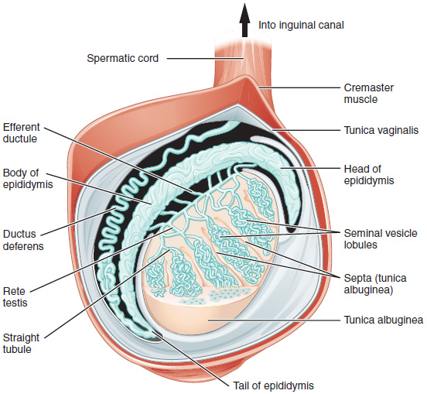
THE TESTICLE
Notes:
Testosterone release is controlled by the APLH whereas sperm production is controlled both by the APFSH and gonadal testosterone.
Each testis contains about 800 narrow twisting tubes, called seminiferous tubules, that are lined with cells that, upon maturation, divide to form the sperm.
The seminiferous tubules merge and form a larger tube, the epididymis. Sperm travels from the testis through the epididymis to the vas deferens, which carries the sperm to the urethra.

Slide 7
In summary the advantages and disadvantages of surgical sperm collection methods are:
Technique | Advantages | Disadvantages
MESA | Large numbers of sperm in one procedure Little contamination with blood | Requires microsurgical skills Maybe be better done on regional or general anesthesia Higher cost to patient
PESA | No microsurgical skills needed Fast Minimally invasive | Sometimes low sperm yield Less reliable Low chance on second attempt
TESE | No microsurgical skills needed Reliable acquisition of sperm | More invasive percutaneous procedure Chance of testicular hematoma Removal of testicular parenchyma
TFNA | Fast Minimally invasive | Very low sperm yield Yields inadequate for cryopreservation

Slide 8
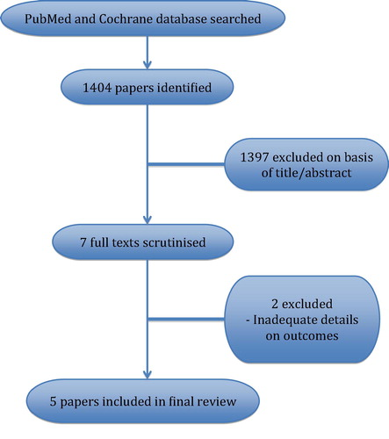
SCHOLARLY REVIEWS OF SURGICAL SPERM COLLECTION TECHNIQUES

Slide 9
Meta-analysis by Bernie et al.,2015- Compared SRR by testicular sperm aspiration (TESA), cTESE and micro-TESE. They found that cTESE was twice more likely to find sperm than TESA, and that micro-TESE was 1.5-times more likely to find sperm as compared to cTESE.

Slide 10
Luciana Semião- et al., 2010 - Assisted reproductive technology outcomes in azoospermic men: 10 years of experience with surgical sperm retrieval.
Submission showed no statistically significant differences were detected between the TESA and PESA groups and the OA and NOA groups, respectively.

Slide 11
Eliyahu Kresch, et al., 2012 - Novel methods to enhance surgical sperm retrieval: a systematic review.
Artificial intelligence technology can play a role in the identification of sperm and, perhaps, better-quality sperm for use with assisted reproduction

Slide 12
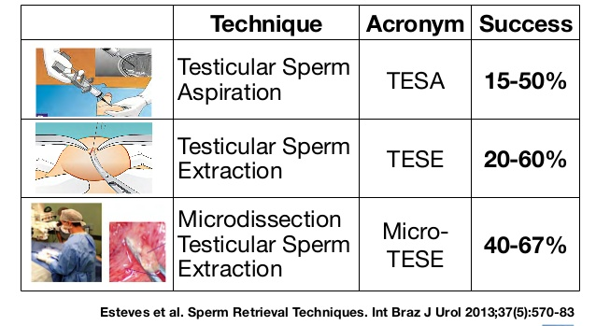
REVIEWS ON SURGICAL SPERM RETRIEVAL TECNIQUES & SUCCESS RATE

Slide 13
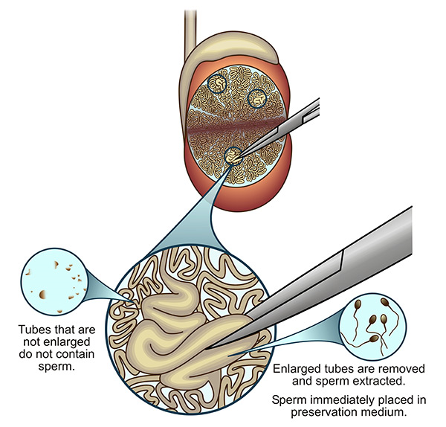
Micro Testicular Sperm Extraction
All reviews found microdissection testicular sperm extraction (micro-TESE) to have the highest¹⁰

Slide 14
SCHOLARLY REVIEW OF SURGICAL SPERM RETRIEVALS IN TERMS OF VITALITY AND MOTILITY
A successful Surgical Sperm Collection procedure is indicated by the presence of sperm cells irrespective of the sperms’ motility status. However, motility indicates vitality
Other methods to ascertain vitality
Hypo osmotic swelling test
Sperm tail flexibility test
Chemical initiation of tail action (pentoxifylline and theophylline).
Laser-assisted immotile sperm selection.

Slide 15
Hypo osmotic swelling test
Pregnancy following intracytoplasmic sperm injection of immotile spermatozoa selected by the hypo-osmotic swelling-test: a case report
S Ved ¹, M Montag, A Schmutzler, G Prietl, G Haidl, H van der VenIn
A couple with complete male asthenozoospermia the possible use of the hypo-osmotic swelling test to select spermatozoa for microinjection was examined. Following incubation in hypo-osmotic medium (Hypo 10, IVF Science, Göteborg, Sweden), 26% of immotile spermatozoa showed signs of sperm swelling (HOS-positive)
It is concluded that selection of spermatozoa by hypo-osmotic swelling-test prior to sperm microinjection seems to be a valuable tool to increase the fertilization rate in cases with complete asthenozoospermia.
High fertilization rate obtained after intracytoplasmic sperm injection with 100% nonmotile spermatozoa selected by using a simple modified hypo-osmotic swelling test:J Liu 1, Y L Tsai, E Katz, G Compton, J E Garcia, T A Baramki
Case study
The hypo-osmotic swelling test with 150-mOsm NaCl solution was used to select viable spermatozoa before ICSI
This hypo-osmotic swelling test with 150-mOsm NaCl solution is a simple and efficient method for selection of viable spermatozoa. A high fertilization rate can be obtained using ICSI with viable spermatozoa selected by using this hypo-osmotic swelling test.

Slide 16
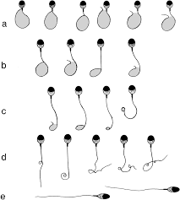
Hypo osmotic swelling test result
Swelling regions are indicated as hatched area: (a) swelling grade 3 – most upper portion of swollen area reached above level of upper third of the tail; (b) swelling grade 2 – partial swelling but reached to level of middle-third of tail; (c) swelling grade 1 – lesser degree of swelling that reached to lower third or below of tail; (d) swelling grade 0-R – non-swelling but reactive. A coiled tail with formation of loopholes between tail and neck of tail; and (e) swelling grade 0 – completely no swelling non-reactive in tail

Slide 17
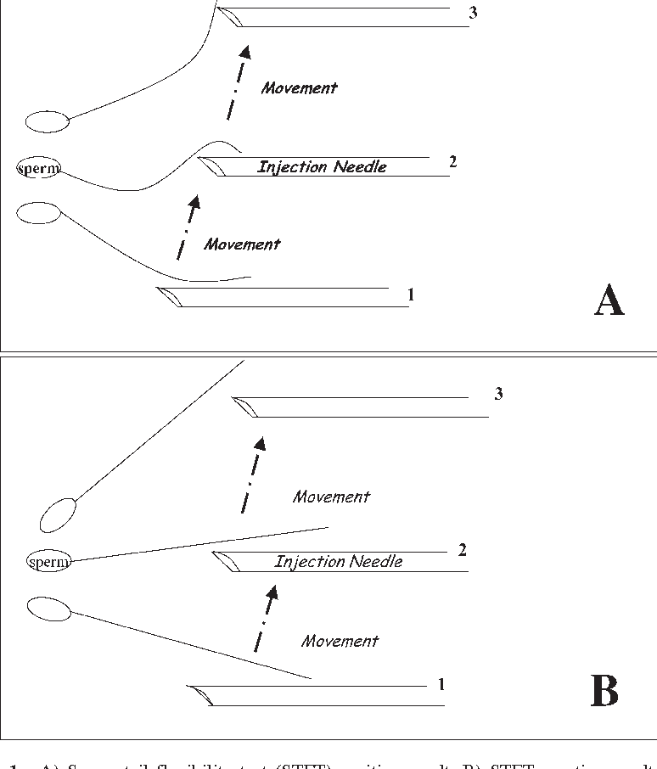
Sperm tail flexibility test
Illustration
Sperm tail flexibility test: a simple test for selecting viable spermatozoa for intracytoplasmic sperm injection from semen samples without motile spermatozoa
Jonathas Borges Soares ¹, Sidney Glina, Nelson Antunes Jr, Roberta Wonchockier, Andrea Giannotti Galuppo, Françoise Elia Mizrahi
Conclusion: The sperm tail flexibility test (STFT) is an easy and cost-effective way for selecting viable immotile spermatozoa and can be used as an alternative method for determining the viability of spermatozoa. This test seems to be a simple and risk-free method when compared to the swelling test.

Slide 18
Chemical initiation of tail action (pentoxifylline and theophylline).
Outcome of ICSI using pentoxifylline or theophylline to identify viable spermatozoa in patients with all immotile spermatozoa
M. Javed, O. Abdulrazzak H. Matrafi S. Najashi H. Sufyan
Pentoxifylline and Theophylline were added to ICSI drops and eggs were injected with motile or shaking sperm whenever available.
Theophylline is safe in identifying viable sperm for ICSI in cases of all non-motile sperm. Pentoxifylline resulted in significantly higher miscarriages.
Outcome of ICSI Cycles using Pentoxifylline or Theophylline to Identify Viable Spermatozoa in Patients with all Immotile Spermatozoa
October 2017Obstetrics & Gynecology International Journal 8(1) DOI:10.15406/ogij.2017.08.00276
Conclusion: These results indicate that theophylline is safe in identifying viable sperm for ICSI in cases with all non-motile sperm in fresh or frozen semen samples or those retrieved by surgical procedure

Slide 19
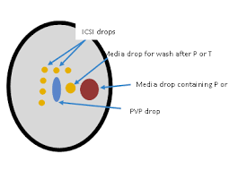
Pentoxifylline vs Theophylline
 | Male Age (Mean±SD) | Female Age (Mean±SD) | # ICSI (Mean±SD) | # Fert (Mean±SD) | # ET (Mean±SD) | Preg Bio # (%) | preg Clin #(%)
Pentoxifylline | 38.3±11 | 32.2±6.4 | 9.0±6.6 | 4.5±3.6 | 2.0±0.7 | 11 (32.4) | 7 (20.6)
Theophylline | 39.2±10.7 | 31.5±6.1 | 8.4±5.0 | 3.6±2.7 | 2.0±0.7 | 26 (33) | 17 (22)
Overall | 38.9±10.7 | 31.7±6.2 | 8.6±5.6 | 3.9±3.0 | 2.0±0.7 | 37 (33) | 24 (21)

Slide 20
Laser-assisted immotile sperm selection
Successful pregnancy following laser-assisted selection of viable but immotile spermatozoa for intracytoplasmic sperm injection: A report of 2 cases]
Huan-hua Chen, Gui-xue Feng, Bo Zhang, Jin-hui Shu, Xian-you Gan, Hong Zhou, Ruo-yun Lin
Conclusion: Noncontact diode laser is a useful alternative for the assessment of sperm viability, which may help to achieve successful pregnancy.

Slide 21
HOW TO PROCESS SSC SEMEN SAMPLE FOR ICSI
Mechanical homogenization of surgically collected samples using scapple blade, needles, glass slides etc.
Rinse the homogenate in sperm preparation media
Check for motility
Communicate with the doctor to either close or move to the next testis
move the homogenate into tubes from the processing culture dish
Label the tube appropriately and recommend the best tube for loading
Load the sample into the lagoon of the Injection dish for ICSI

Slide 22
WHAT NEXT WHEN SSC FAILS ?????
Counsel the patient
If donor sperm had been chosen, ICSI with the selected Donor sperm
Cryopreservation of Oocyte
Failed cycle discussion

Slide 23
HANDS-ON NUGGETS AND SUGGESTIONS FOR SUCCESSFUL SSC
Be sure you have a good surgeon
Wash the sample well before homogenizing the sample
Incubate sample in media for about 2 hours before loading into ICSI dish
Load step wisely, avoid the edge of the lagoon
Do not drag your needle in the lagoon
When you see a sperm cell twitch or move pick it
Make sure you clean the sperm cell in PVP before slashing
Pick your sperm cells before loading the eggs
Play music

Slide 25
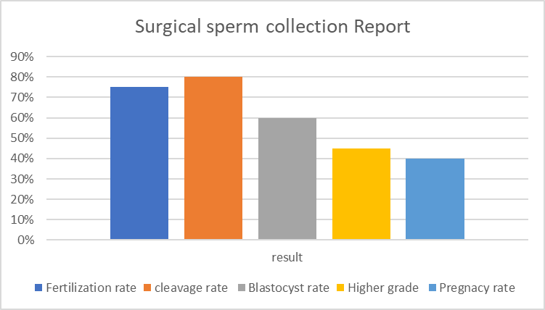
CLINICAL FINDINGS
Data from 5 IVF laboratories in Nigeria
40 cases from 2019 – 2021
Success rate for Surgical Sperm collection is 90%

Slide 26
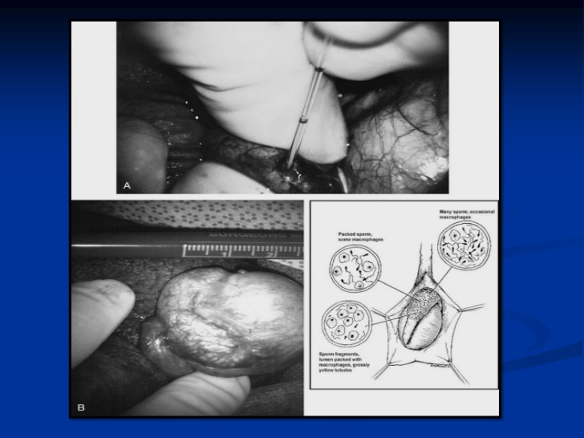
DISCUSSION
Low FSH, age and size of the testis are indicative of a successful SSC
The success of SSR is largely dependent on the skill of the Surgeon
Micro-TESE is the most reliable option
Identification of the seminiferous tubules is key to a successful SSR
For NOA and OA SSR option should be explored before offering any patient Donor Sperm
SSR sperm cells give rise to healthy babies.
Laser, osmotic swelling test, sperm flexibility test and the use of chemicals are effective methods to test vitality in the absence of motility for SSC

Slide 27
CONCLUSION
Micro-TESE is the most efficient method for retrieving sperm but requires special expertise and can be traumatic for the testes.
SSC cycles have fairly similar results to compared ejaculated sperm cycles.
Unsuccessful sperm retrieval has both financial and emotional implications, therefore the client should be counseled on the outcome of the sperm retrieval.

Slide 28
REFERENCES
10. Schlegel PN, Su LM. Physiological consequences of testicular sperm extraction. Hum Reprod 1997;12:1688-92.
Ron-El R, Strauss S, Friedler S, Strassburger D, Komarovsky D, Raziel A. Serial sonography and colour flow Doppler imaging following testicular and epididymal sperm extraction. Hum Reprod 1998;13:3390-3
Schlegel PN, Li PS. Microdissection TESE: Sperm retrieval in non-obstructive azoospermia. Hum Reprod Update 1998;4:439.
Belenky A, Avrech O, Bachar G, Zuckerman Z, Ben Rafael Z, Fisch B, et al. Ultrasound-guided testicular sperm aspiration in azoospermic patients: A new sperm retrieval method for intracytoplasmic sperm injection. J Clin Ultrasound 2001;29:339-43.
Herwig R, Tosun K, Schuster A, Rehder P, Glodny B, Wildt L, et al. Tissue perfusion-controlled guided biopsies are essential for the outcome of testicular sperm extraction. Fertil Steril 2007;87:1071-6.
Verheyen G, Joris H, Crits K, Nagy Z, Tournaye H, Van Steirteghem A. Comparision of different hypo-osmotic swelling solutions to select viable immotile spermatozoa for potential use in intracytoplasmic sperm injection. Hum Reprod Update 1997;3:195-203.
Tournaye H, Liu J, Nagy Z, Verheyen G, Van Steirteghem A, Devroey P. The use of testicular sperm for intracytoplasmic sperm injection in patients with necrozoospermia. Fertil Steril 1996;66:331-
Nagy Z, Liu J, Cecile J, Silber S, Devroey P, Van Steirteghem A. Using ejaculated, fresh, and frozen-thawed epididymal and testicular spermatozoa gives rise to comparable results after intracytoplasmic sperm injection. Fertil Steril 1995;63:808-15.
Temple-Smith PD, Southwick GJ, Yates CA, Trounson AO, de Kretser DM. Human pregnancy by in vitro fertilization (IVF) using sperm aspirated from the epididymis. J In Vitro Fert Embryo Transf 1985;2:119-22.
Patrizio P, Silber S, Ord T, Balmaceda JP, Asch RH. Two births after microsurgical sperm aspiration in congenital absence of vas deferens. Lancet 1988;2:1364.
Shah RS. Operative sperm retrieval for ART. In: Goenka ML, Goenka D, editors. Recent Advances in Infertility Management. Guwahati: Goenka; 2001. p. 179-83.
Shrivastav P, Nadkarni P, Wensvoort S, Craft I. Percutaneous epididymal sperm aspiration for obstructive azoospermia. Hum Reprod 1994;9:2058-61.
Craft I, Bennett V, Nicholson N. Fertilising ability of testicular spermatozoa. Lancet 1993;342:864.
Schoysman R, Vanderzwalmen P, Nijs M, Segal L, Segal-Bertin G, Geerts L, et al. Pregnancy after fertilisation with human testicular spermatozoa. Lancet 1993;342:1237.
Devroey P, Liu J, Nagy Z, Tournaye H, Silber SJ, Van Steirteghem AC. Normal fertilization of human oocytes after testicular sperm extraction and intracytoplasmic sperm injection. Fertil Steril 1994;62:639-41.
Devroey P, Liu J, Nagy Z, Goossens A, Tournaye H, Camus M, et al. Pregnancies after testicular sperm extraction and intracytoplasmic sperm injection in non-obstructive azoospermia. Hum Reprod 1995;10:1457-60

Slide 29
THANK YOU FOR LISTENING

Slide 30
QUESTIONS?????????????

